Slide 1
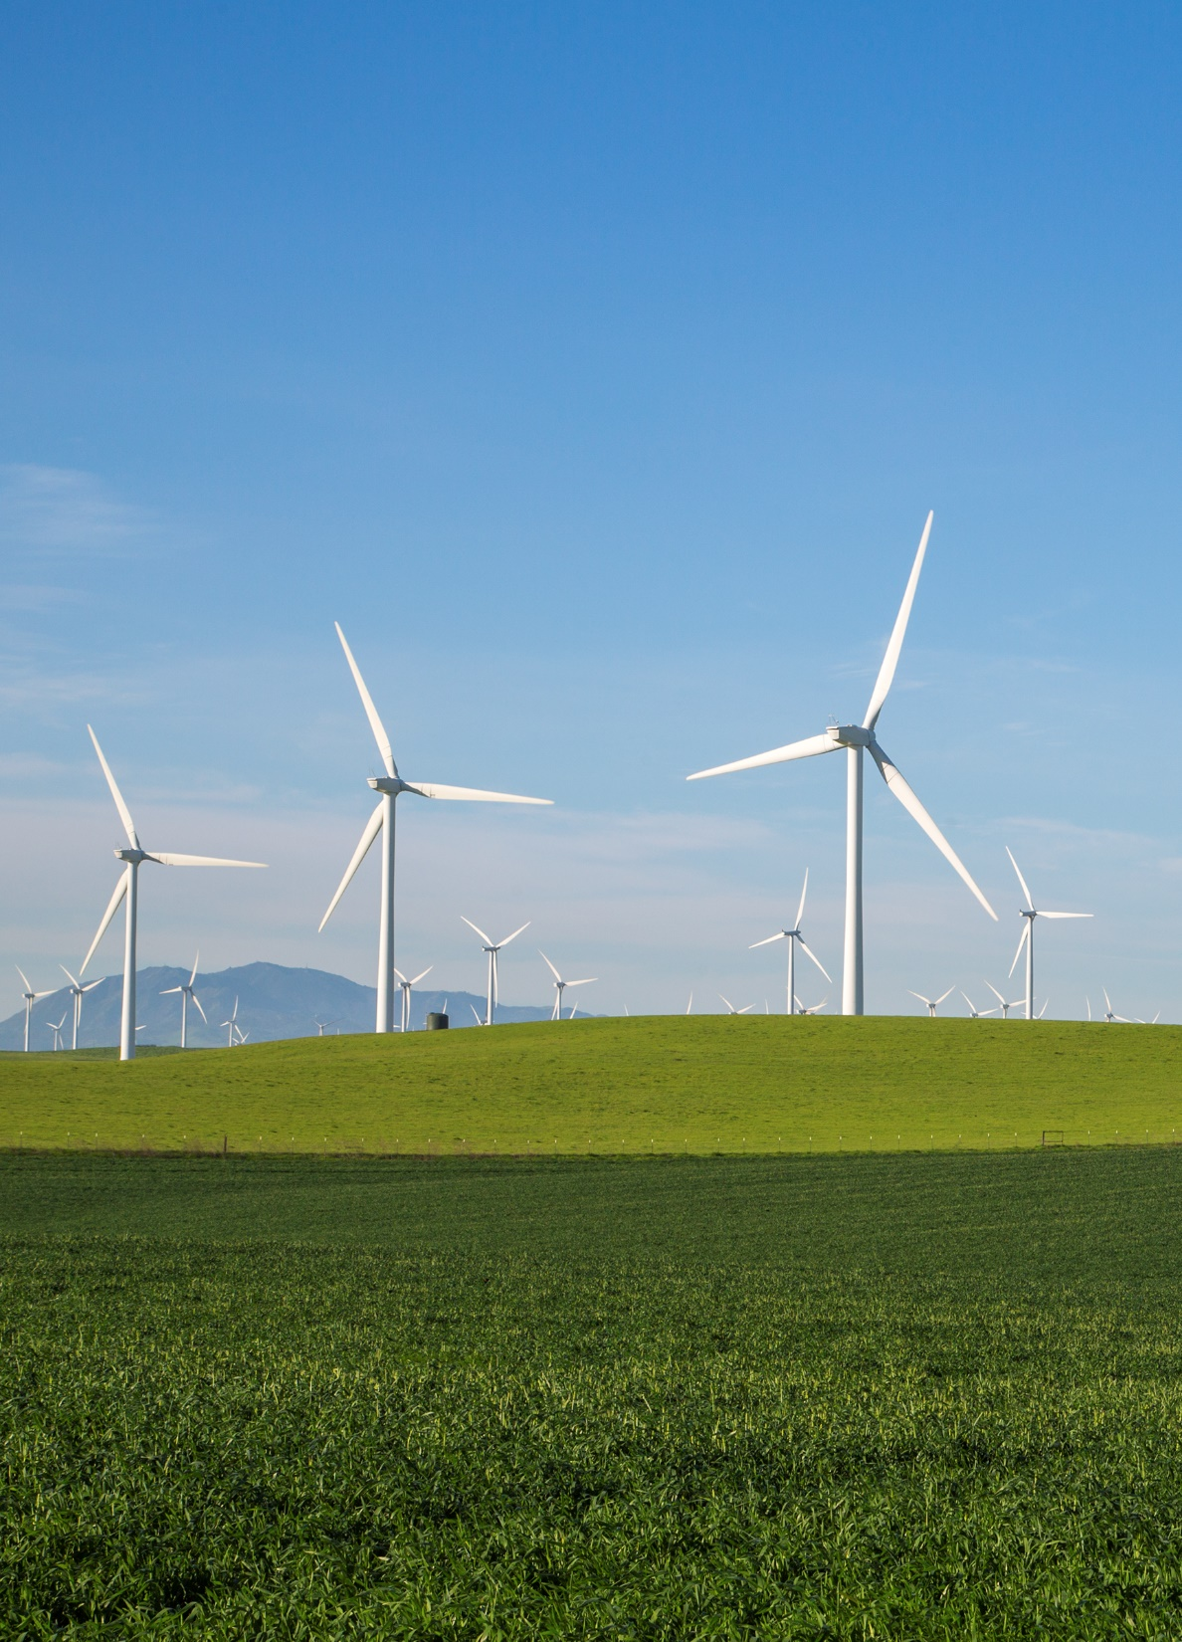
Upcoming CleanPowerSF Marketing Campaigns
Elisa Rodriguez Furey
Cassidy Wallerstein
April 11, 2023

Slide 2
CleanPowerSF Campaigns
Spring 2023
Heat Pump Water Heater and Electrification Campaign
SuperGreen Upgrade Campaign

Slide 3
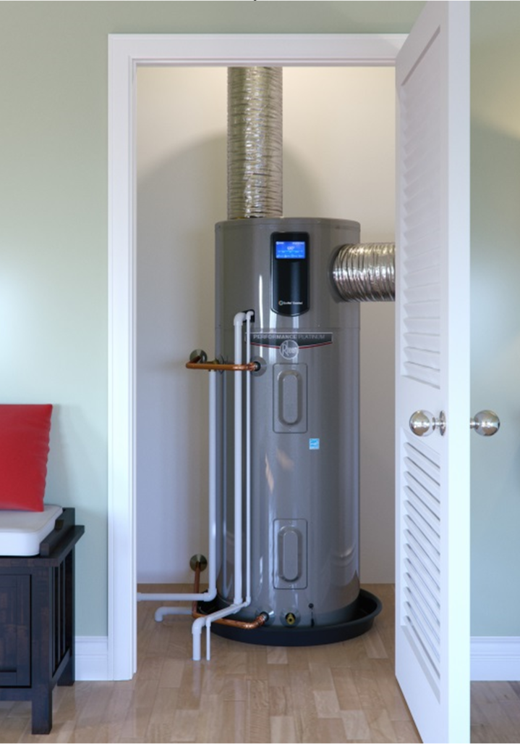
Heat Pump Water Heater & Electrification Campaign

Slide 4
Campaign Overview
Goals
Increase adoption of heat pump water heaters
Raise awareness among San Francisco residents about the benefits of electrification
Encourage San Francisco residents to learn more and consider going electric in their home
Increase CleanPowerSF brand recognition
Drive traffic to CleanPowerSF website
Consultant: True North, Inc.
April– May 2023

Slide 5
Creative Concept
Notes:
Two-pronged marketing campaign strategy:
(1) Target “early adopters” or those more-likely to make the switch to a heat pump water heater:
CleanPowerSF customers (Net Energy Metering, EV owners, SuperGreen)
New homebuyers (past 12 months)
Residents with a >10 year old natural gas water heater (based on DBI permit data)
(2) Promote electrification awareness to a greater audience
Encourage SF residents to “break up with gas” and go all-electric at home, whether through a heat pump water heater, induction cooktop, etc.

Slide 6
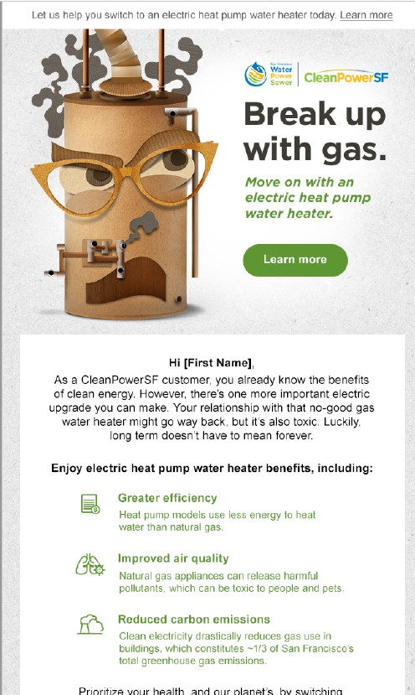
Heat Pump Water Heater Marketing
Target Audience CleanPowerSF customers New homebuyers
Residents w/ aging water heaters
Tactics
Email
Direct mail
Call to Action Learn more / Claim your rebate www.cleanpowersf.org/waterheater
Timing End of April – May

Slide 7
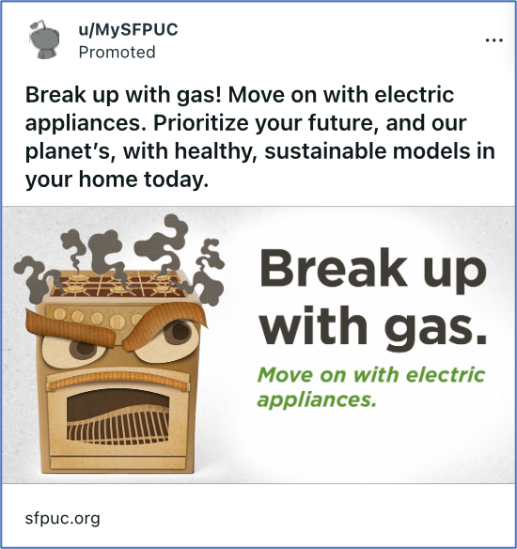
Electrification Advertising
Target Audience Early adopters
Sustainability interest EV owners
Tactics
Paid Advertising
Facebook/Instagram
Reddit
EV Charging Stations
Call to Action Learn more www.cleanpowersf.org/goelectric
Timing April 11th – May 15th

Slide 8
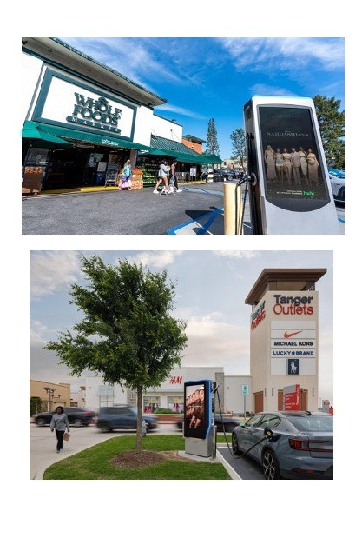
EV Charging Station Ads
Creative 50 screens/4 venues, one 8-second ad per 64-second loop
Impressions
1 million
Locations:
2100 Webster Street Care Center - California Pacific Medical Center
CCSF - Ocean Campus
Stonestown Galleria
UCSF Parnassus

Slide 9
SuperGreen Upgrade Marketing Campaign

Slide 10
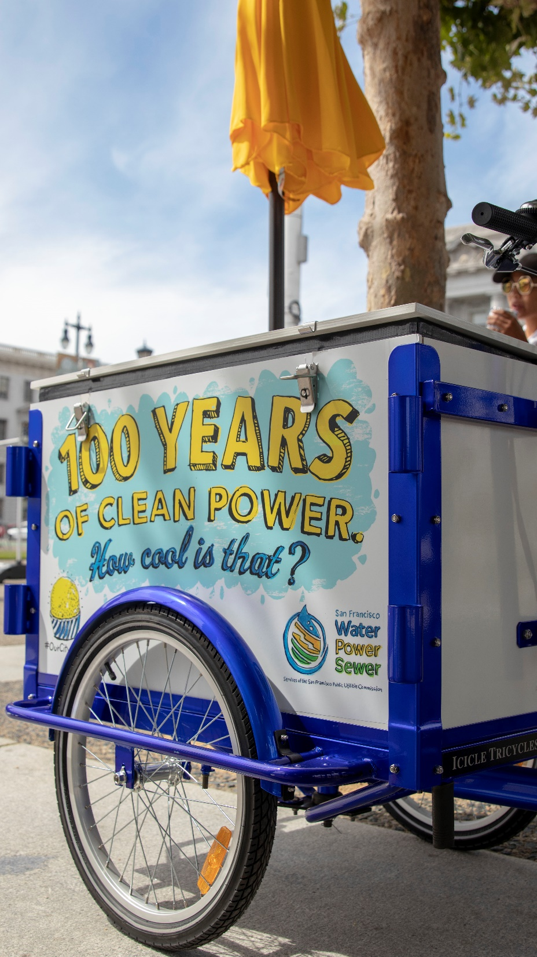
Campaign Overview
Digital advertising campaign and in-person activations
Goals
Drive enrollment in SuperGreen
Increase awareness of CleanPowerSF
Increase direct customer engagement (in-person outreach)
Offer an action San Francisco residents can take during Climate Action Month
Consultant: Most Likely To
April 2023

Slide 11
Target Audiences
CleanPowerSF residential customers
Renters
Speak languages other than English (Spanish and Chinese)
Moderate to low-income residents

Slide 12
Digital Advertising Campaign Tactics
Leverage tactics that allow us to target our specific audiences
Examples include:
Social media (Facebook, Instagram)
Online and traditional radio (iHeart, Sing Tao Radio)
Digital ads (Univision.com)

Slide 13
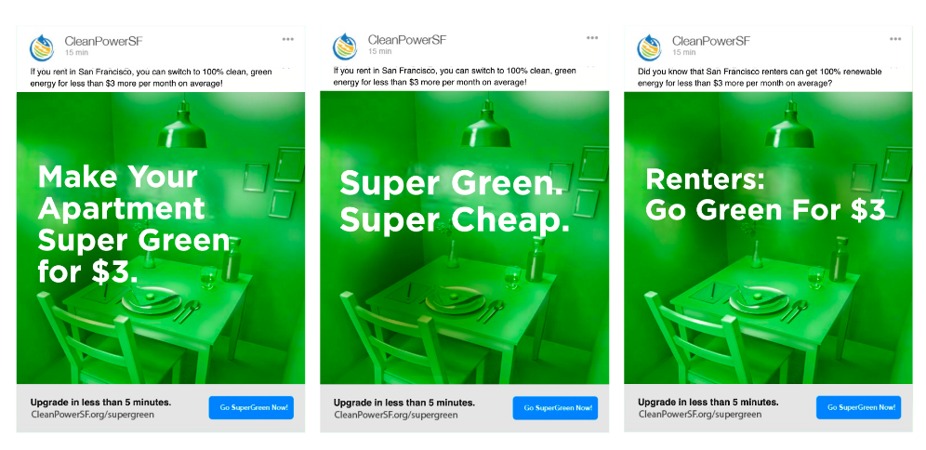
Digital Campaign Creative Concepts

Slide 14
In-person Activations
Multiple activation(s) to engage customers in person
Cherry Blossom Festival
Earth Day Golden Gate Park
Latino Task Force Event Mission District
Sundays Streets Bayview Hunters Point
Green apartment set photo op
SuperGreen/SuperGreen Saver sign-ups

Slide 15
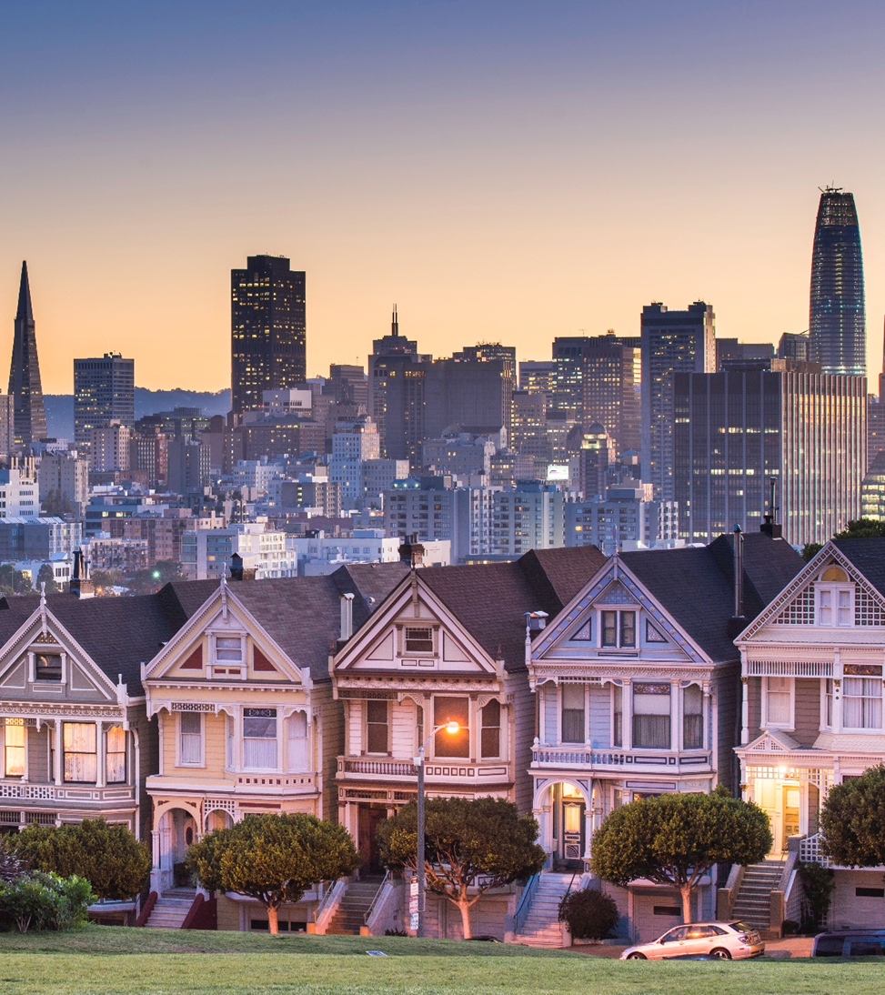
Thank You

